Slide 1
Block chain and Artificial Intelligence
Block chain and Artificial Intelligence (AI) are two transformative technologies that, when combined, can enhance security, transparency, and automation in various industries.

Slide 2
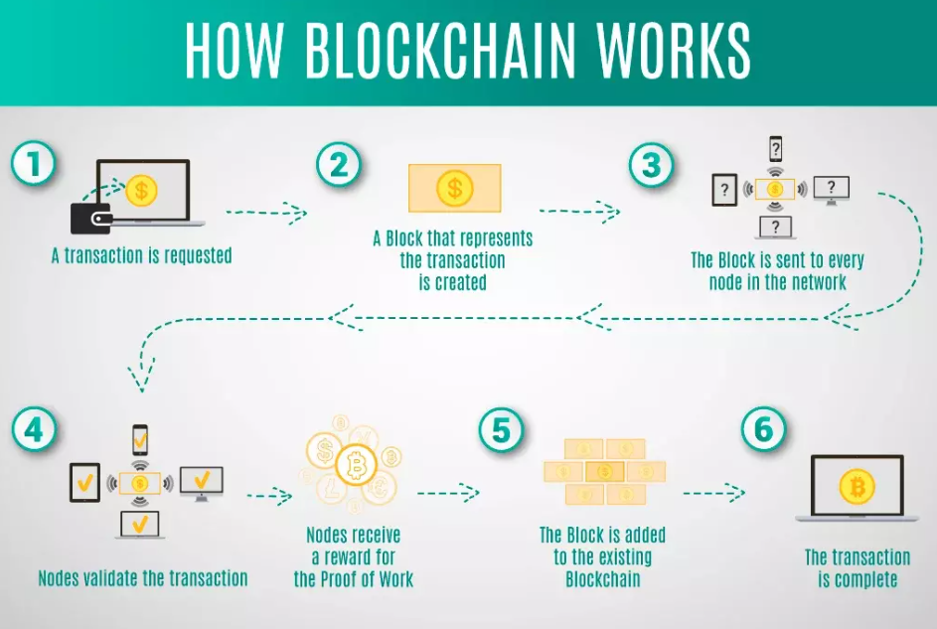
A Blockchain is a distributed database, which is shared over a computer network. Blockchain stores information electronically in a digital format to make transactions secure. Blockchain is a new technology, which is known as Distributed Ledger Technology (DLT).

Slide 3
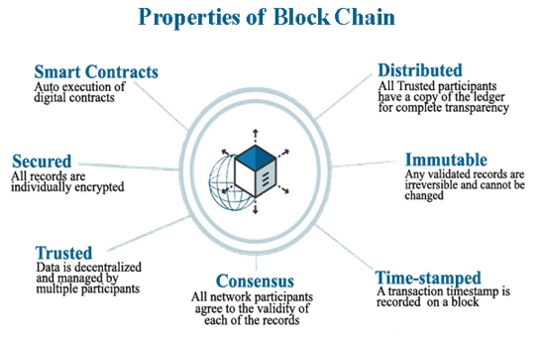

Slide 4
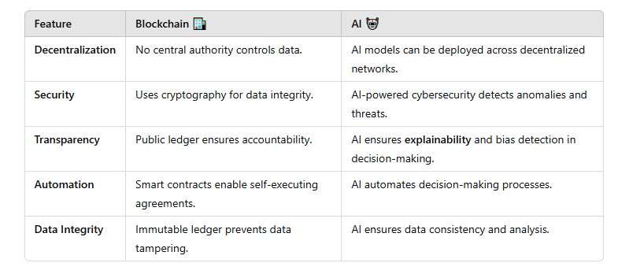
Key Features of Block chain & AI
A smart contract is a computer program that automatically executes when certain conditions are met.

Slide 5
How Block chain and AI Work Together
1. Secure & Transparent AI Decision-Making
🔹 Blockchain can store AI-generated decisions securely, ensuring they are tamper-proof and auditable. 🔹 Useful in finance, healthcare, and legal sectors where AI decisions need to be trusted.
2. Decentralized AI Training & Computing
🔹 AI models can be trained on blockchain-based distributed networks instead of relying on centralized cloud servers. 🔹 Reduces the risk of data breaches and central authority control.
3. Data Privacy & Ownership
🔹 Blockchain allows users to control their personal data while AI can analyze it securely. 🔹 Used in healthcare (patient records) and finance (secure identity verification).
4. AI-Powered Smart Contracts
🔹 Smart contracts execute automated transactions on the blockchain. 🔹 AI enhances contract analysis, fraud detection, and decision-making in smart contracts.
5. Improved Cybersecurity & Fraud Prevention
🔹 AI detects suspicious activities and blockchain ensures tamper-proof records. 🔹 Used in banking, e-commerce, and identity verification.

Slide 6
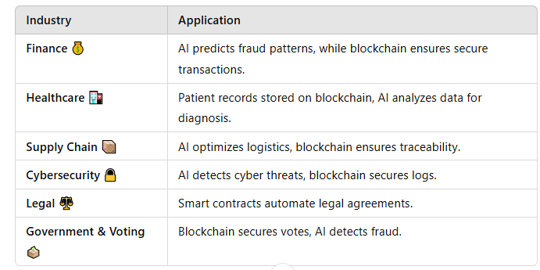
Applications of Block chain & AI

Slide 7
Challenges in Block chain & AI Integration
Scalability – Both technologies require high computational power.
Complexity – Integration is difficult due to technical challenges.
Regulatory Issues – Compliance and legal frameworks need to evolve.
Energy Consumption – Both AI training and block chain mining require significant energy.
Future of Block chain & AI
AI-driven decentralized apps (DApps) will enhance automation.
Self-learning smart contracts will revolutionize legal agreements.
AI-powered fraud detection on blockchain networks will increase security.
Web3 & Metaverse will integrate AI and blockchain for immersive experiences.

Slide 8
The combination of Block chain & AI enhances trust, automation, and security across industries. While challenges exist, their integration will drive the future of decentralized, intelligent systems.

